Slide 1

Blazor vs Angular vs React
Artsem Kanapliou for .NET Division Research & Development Function
Notes:
Hi!
My name is Artsem. I’m a senior software engineer from the .NET division.
I’m with Godel for about 5 years, and for approximately 2 of them I was working 90% of my time on React solutions.
So, I love React and it was interesting to take a closer look at Angular and Blazor.

Slide 2

What are we going to do today?
We will try to compare React, Angular and Blazor
It will be a broad high-level overview
You will get a starting point for your own investigation
Notes:
We will try to compare three front-end solutions: React, Angular and Blazor.
Obviously, It’s not possible to cover everything and my goal is to give a broad comparison so that you have something to start with if necessary.
We will take a look at popularity of those frameworks, touch a general principles behind delivering of framework code to the end user, try to create some basic components and check some metrics for sample application.

Slide 3
Those useful UI frameworks
Speed ​​up development
Consistency and Uniformity
Community support
Reduction of efforts
Notes:
What are UI frameworks and what are they for?
As you may already know -- UI frameworks are collections of pre-written code and tools, designed to streamline the development of user interfaces.
They provide a structured way to build and manage an application.
If you use any popular UI framework:
- you will get faster development (because you don’t need to worry about common problems)
- your code will be written in a clean and uniformly styled way
- you will get tested framework code which constantly gets improved by a community as well as a huge knowledge base with documentation
- overall development cost and amount of effort will be lower than if you must create UI tooling from scratch

Slide 4



General information
React by Meta (former Facebook), latest version 18.3.1
UI library
JavaScript/TypeScript as primary language
Angular by Google, latest version 18.0.4
Web framework
TypeScript as primary language
Blazor by Microsoft, latest version 8.0.7
Web framework
C# as primary language
Notes:
React:
A JavaScript library used for building user interfaces. Although it’s not a framework we will be referencing it as one, for the sake of simplicity.
It was developed by Facebook and has become one of the most popular libraries for front-end development.
It supports building components and efficiently updating the UI when data changes.
Angular:
A web application framework developed by Google.
Angular is known for its strong opinions on how applications should be built. It includes powerful templating, dependency injection, and an extensive CLI.
Blazor:
A web framework developed by Microsoft that allows developers to build interactive web UIs using C#.
It's part of the .NET ecosystem and aims to leverage the power and familiarity of C# and .NET for web development.

Slide 5
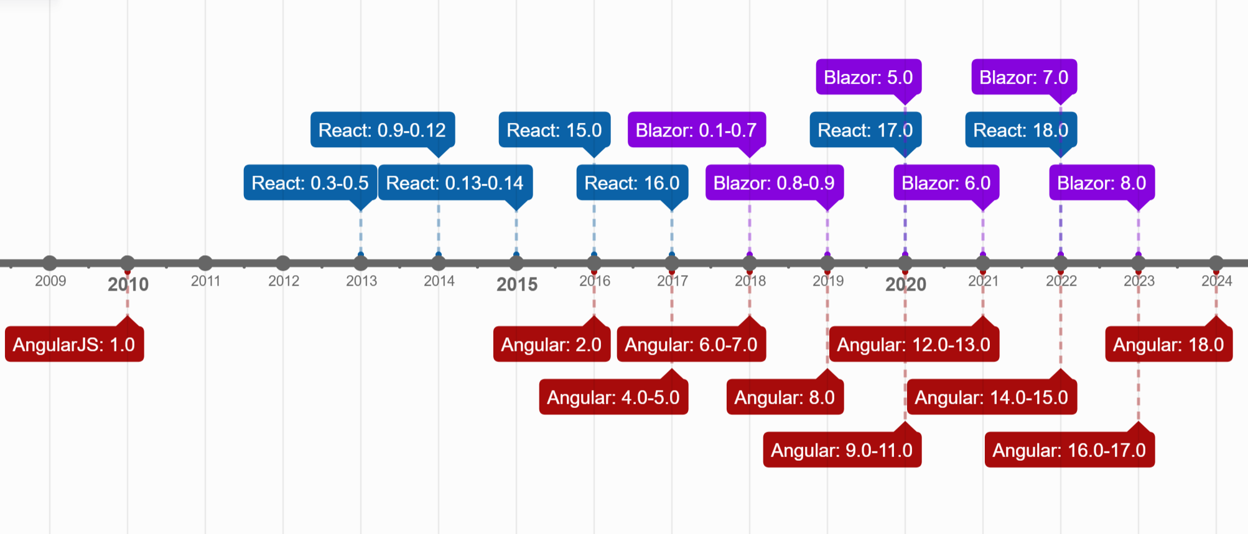
Public releases timeline
Notes:
On this slide you can see timeline for major public versions releases of Angular, React and Blazor.
Angular history is the oldest one of those three, with first release in 2010.
Almost three years after the first Angular release the world saw a new React framework.
The youngest framework in our comparison is Blazor with first publicly available version released in 2018.
We can see that all those frameworks are under constant process of improvement and there are new versions constantly released.

Slide 6
Source code and package
 | React | Angular | Blazor
Source code available | github.com/facebook/react | github.com/angular/angular | github.com/dotnet/aspnetcore/tree/main/src/Components
Main package name | “react” npm package | “@angular/core” npm package | “Microsoft.AspNetCore.Components.WebAssembly” Nuget package
Notes:
There are source codes as well as issue trackers and development history publicly available on Github.
But Blazer doesn't have a separate repository unlike other frameworks. It’s part of aspnetcore development and hence located in corresponding place.
On the following charts you can see some statistics from Github repos and package repositories.
Even though Angular was developed earlier than React, you can already see that React is far beyond its competitors by repository popularity and amount of daily library downloads.
(of course, npm download statistic can’t be directly transferred to the number of library users, but those are incredible numbers for React anyway).
And Blazor is the less popular framework at least today.

Slide 7
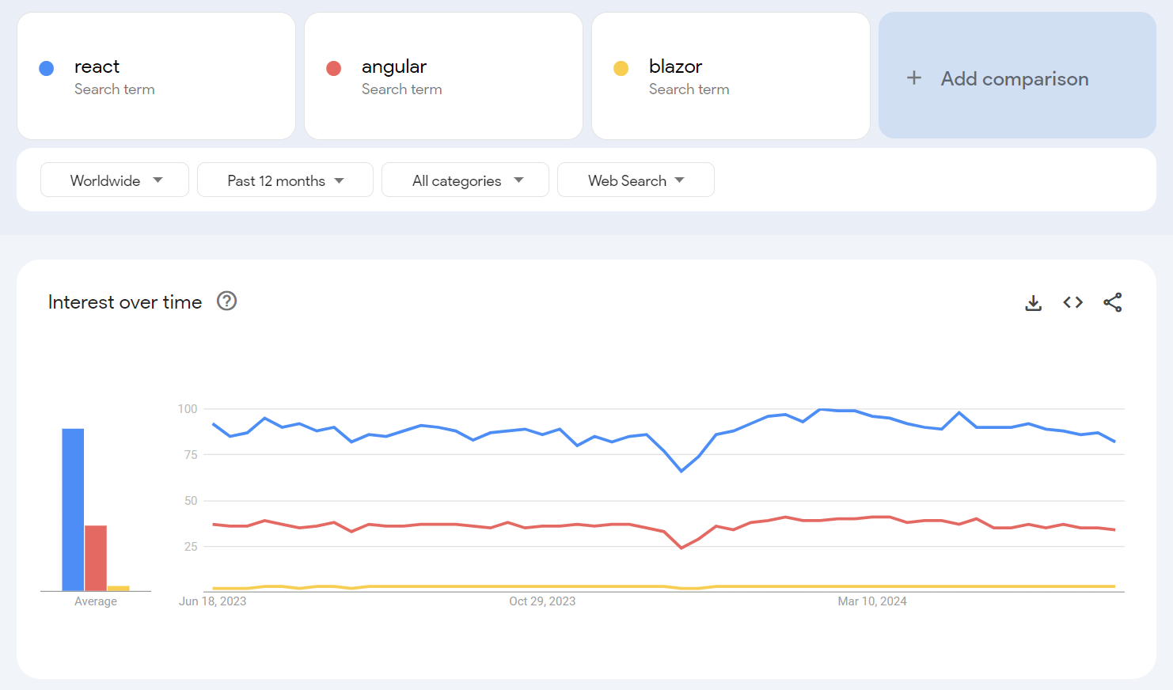
Google trends
Notes:
Here is a final screenshot which basically proves the same things as our previous slide – React is the most popular framework out of the three considered.

Slide 8
What do I need to know to build?
Each framework requires basic knowledge of Web Development (HTML, CSS, JavaScript, HTTP requests)
Each framework implements routing, data binding, event handling, state management, and components lifecycle in a slightly different manner
Notes:
Apart from basic web development knowledge, you must get used to framework specifics before being a confident framework user,
cause the principles under the hood of each framework are similar the actual implementation details are different.

Slide 9
How can I deliver my UI code to a user?
Notes:
Although it is possible to use React, Angular and Blazor for a server-side rendering, today we will be comparing their usage in client’s browser.
We'll start with a general overview of how our code gets to the user.

Slide 10
Dev side
Write components
Client side
The magic of build
Render process
Load page
Configure build process
Initialize framework
Navigate to a site
Update the DOM based on a change detection
Run build tool
Load index.html
Get static files
Download and execute JS
Render the updated DOM
Upload files to a web server
Notes:
If we are talking about all three frameworks, the process will be pretty much the same.
All of them using component-based model, so you’ll be starting with writing components.
You will have to build your code so that it become a bunch of static files.
Those static files will be served from a web server of some sort (be it a static file hosting or some runtime serving those files).
As soon as user opens your page, he will be loading index.html file and your code will be downloaded and executed.
This process of code execution will lead to framework initialization and as soon as a framework is up and running it will start application rendering and user input handling.

Slide 11
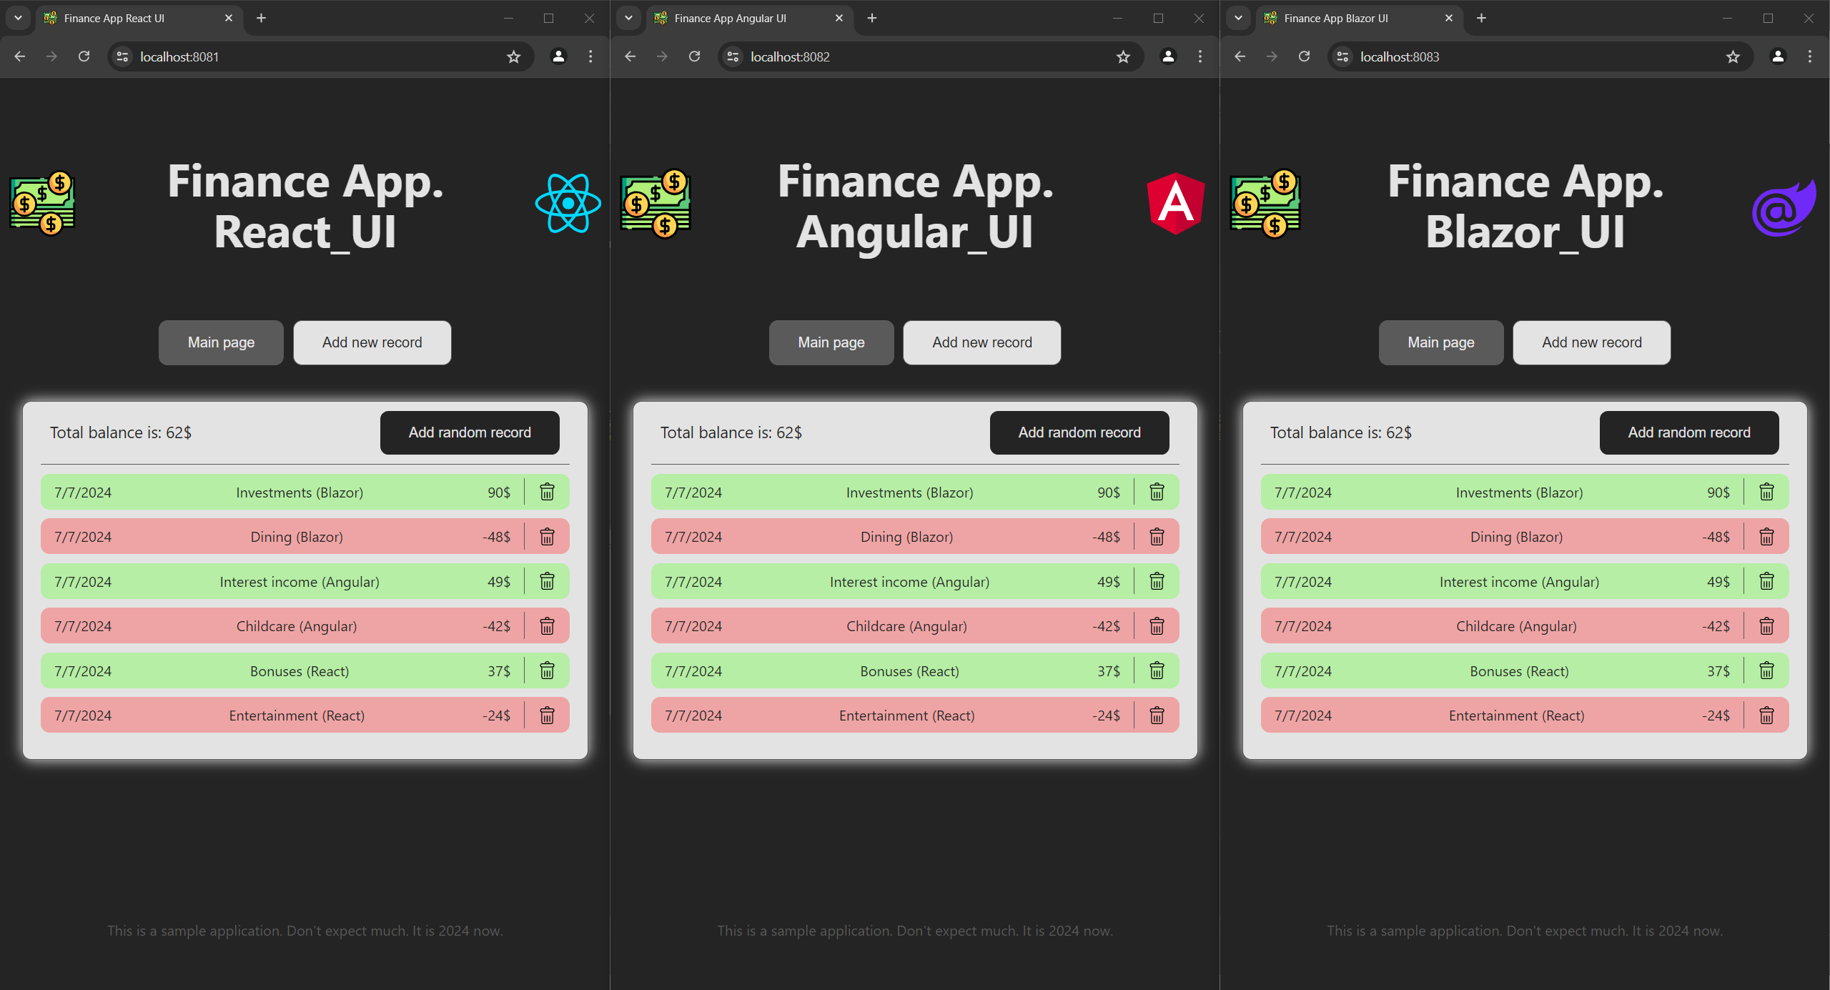
Application example
Notes:
I wrote three identical applications using three different frameworks. And we will jump to code in a few minutes.
To speed up our code diving let’s describe a few aspects in the form of slides.

Slide 12
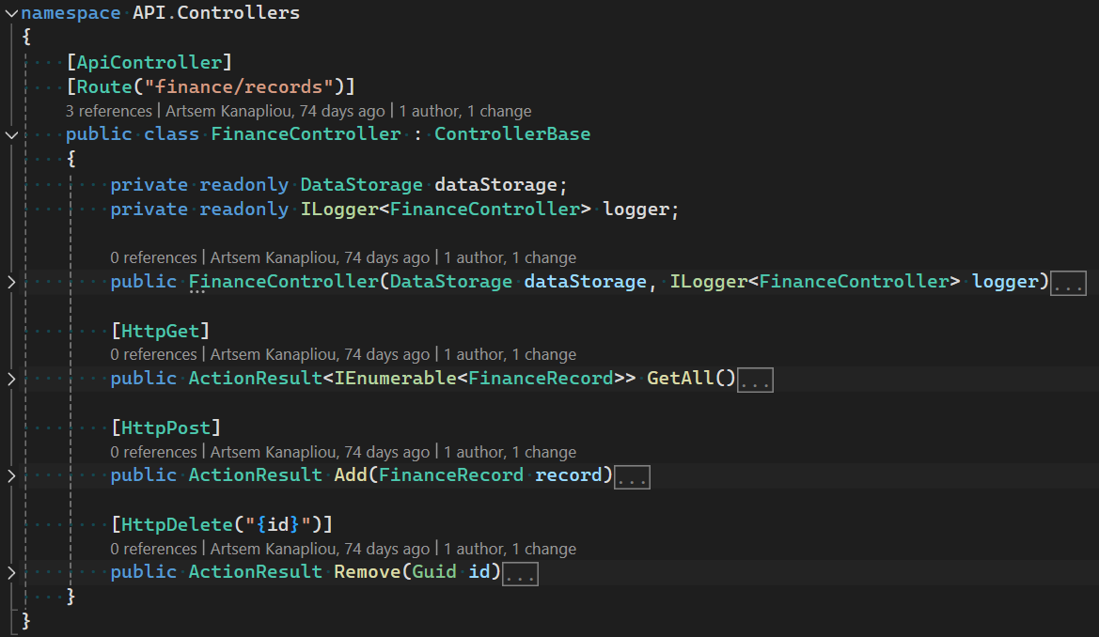
API
Notes:
Firstly, I've got a project with a kind of API capable of basic operations over an in-memory collection of records.

Slide 13
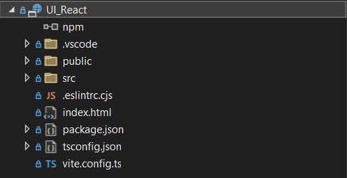
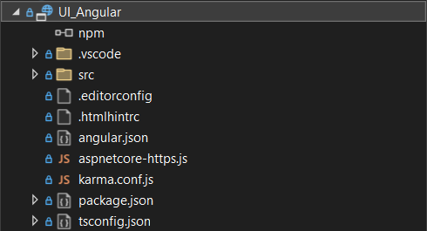
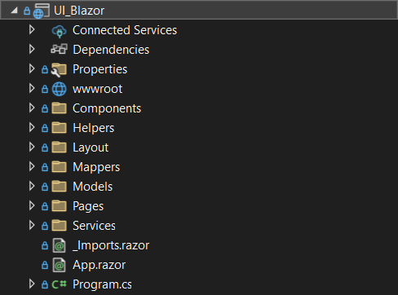
Three UI projects
Notes:
And I've got three projects, one for each framework respectfully.
Those projects were created using basic templates from Visual Studio.

Slide 14
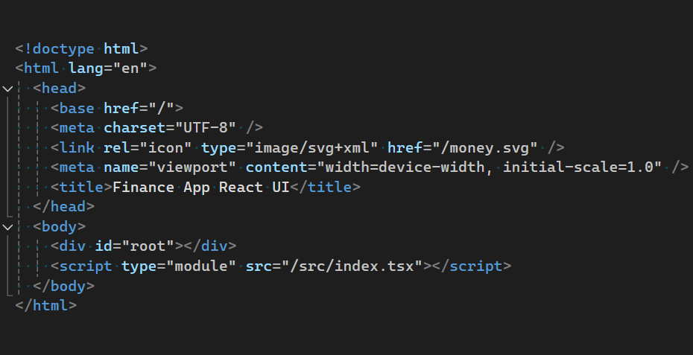
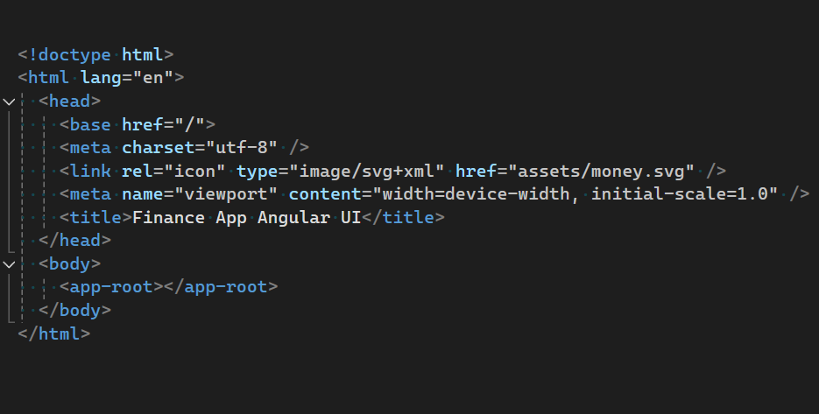
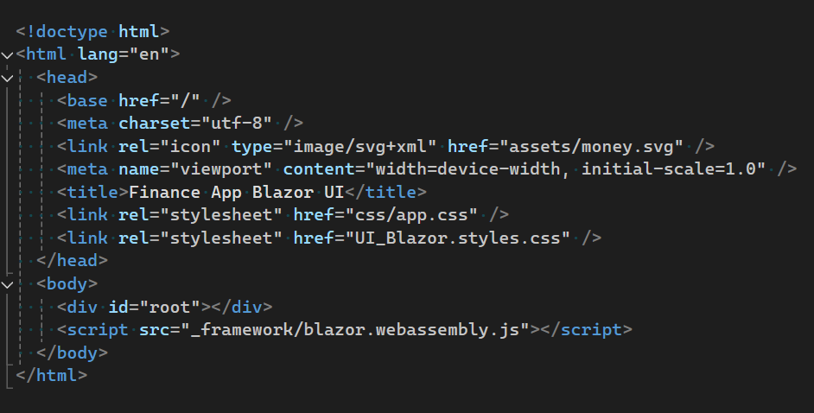
React index.html
Angular index.html
Blazor index.html
Notes:
As those projects are single-page applications, there will be a single-entry point where everything starts for each of them.
I'm talking about index.html files.
As you can see, they look similar (except the fact that Angular is smart enough right from the box to inject code automatically).
So, we know the starting point, but there is nothing to inject at this stage. Let’s dive further into the application code.

Slide 15
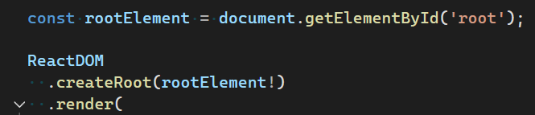

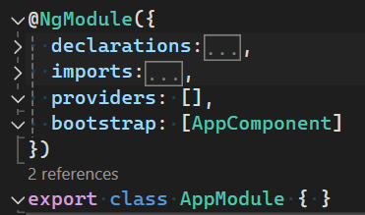

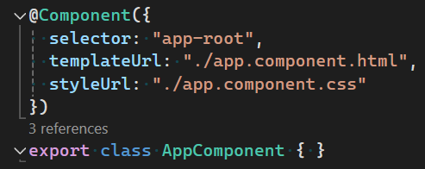
React index.tsx
Angular main.ts
Angular app.module.ts
Blazor Program.cs
Angular app.component.ts
Notes:
Let’s take a look at the framework initialization step.
React needs a real DOM node to start its rendering process.
Angular will try to get the information contained within AppModule.
This module contains instructions and dependencies to bootstrap AppComponent.
Which in turn contains a selector for the root node of our application.
And as you might see Blazor will try to find a DOM node to start with.

Slide 16
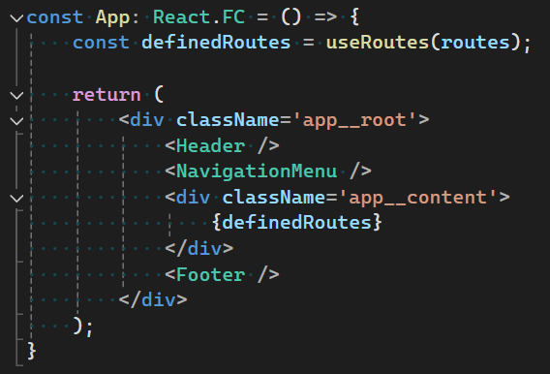
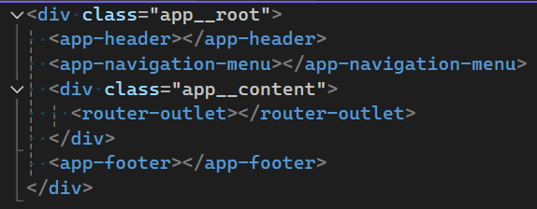
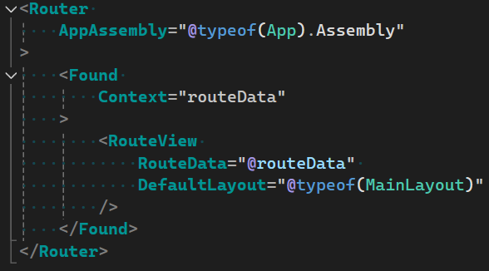
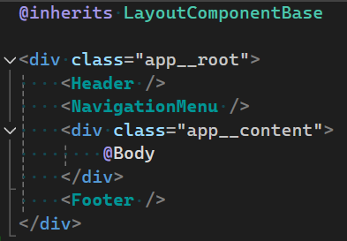
React App.tsx
Angular app.component.html
Blazor App.razor
MainLayout.razor
Notes:
We need some kind of components hierarchy in our application and general rules here will be pretty much the same for all three frameworks.
We define a set of components and HTML nodes as out layout.
And then placing routing somewhere in our structure.
It’s worth mentioning here that routing is an integral part of Blazor and Angular, whereas for React-based solutions it’s an interchangeable third-party library.

Slide 17
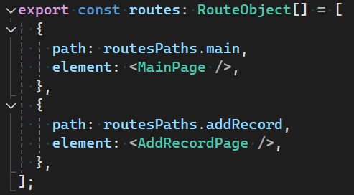
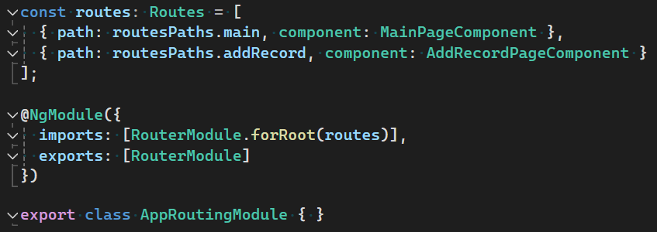


React
Angular
Blazor
Notes:
It’s very easy to configure routing for any of our solutions.
It’s enough to get a list of path-to-component mappings for React and Angular, and Blazor will scrap your routes from the assembly in an automatic way.

Slide 18
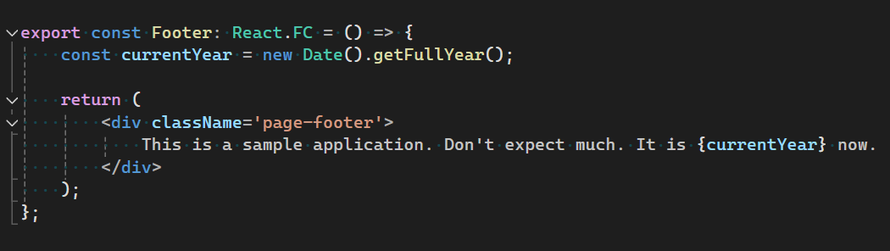
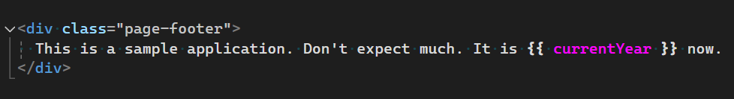
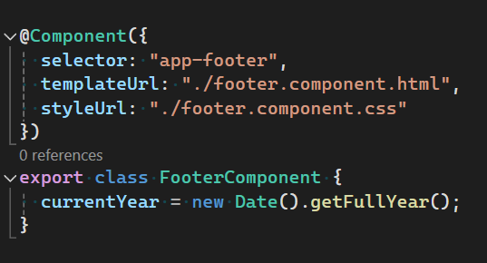
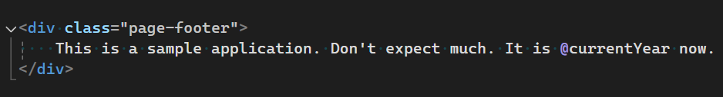
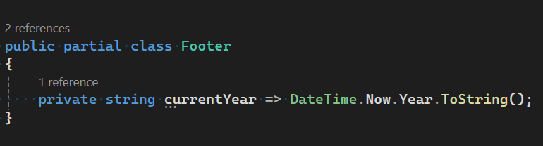
React Footer.tsx
Angular footer.component.html
Angular footer.component.ts
Blazor Footer.razor
Blazor Footer.razor.cs
Notes:
Here you can see an example of the easiest component possible.
It consists of a single line of text and a programmatically assigned variable.
React encourages you to write your code and logic in the same file.
For Blazor and Angular, you’ve got a choice. As for me, it’s very convenient to separate your markup and logic. It’s nice to read and nice to navigate.

Slide 19
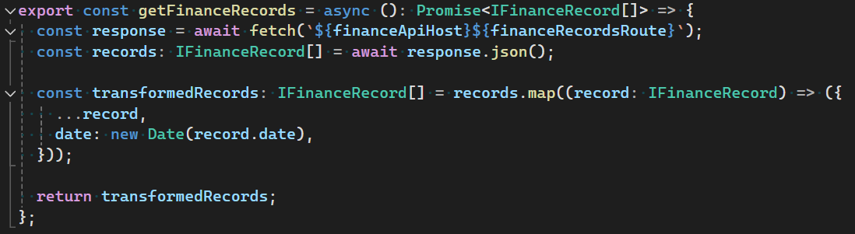
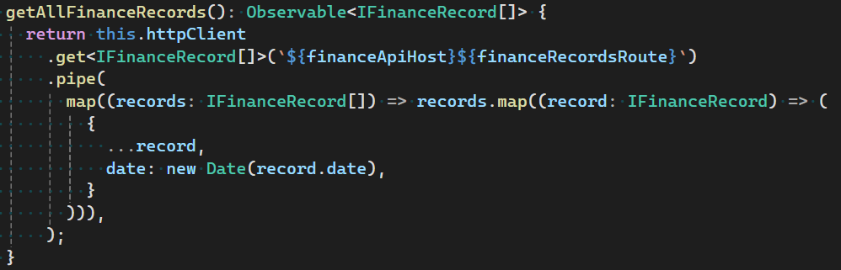
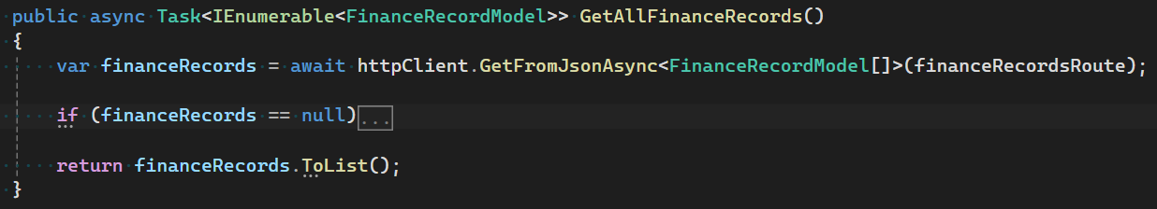

React api/finance.ts
Angular finance-records.service.ts
Blazor FinanceRecordsService.cs
Blazor Program.cs
Notes:
Here you can see a typical get request described with React, Angular and Blazor.
There is no preferred way to do API calls in React, you can use the browser's default Fetch method or install some additional library such as Axios.
Angular comes with ready to use HTTP client, you can inject and use it straight away.
As for Blazor – you must be familiar with good old HTTP Client, and you can continue using this approach. Simply configure, inject and call.

Slide 20
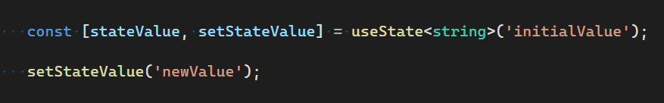
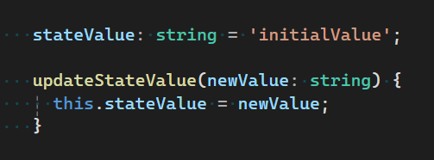
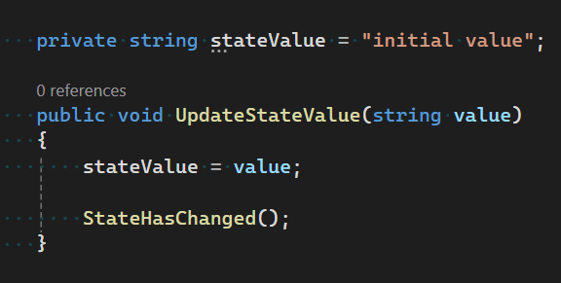
State inside component
React
Angular
Component
State
Blazor
Notes:
Each of the frameworks supports the state on the component level.
This state can be easily created, modified or passed to the child component.
Suitable for simple use cases, does not require sophisticated boilerplate code.

Slide 21
State as a separate service
State Service
State
Component
Component
Component
Component
React FinanceDataContextProvider.tsx
Angular finance-records-store.service.ts
Blazor FinanceRecordsStateContainer.cs
Notes:
And what if you need something more complex than a simple internal state of the component?
What if you need to share your state with different components on the different component tree levels?
In this case, there are a few concepts which are still simple and easy to deal with yet powerful enough when your state is not complex as hell.
The main concept here is that a state is held within a separate entity responsible for managing that state.
For React we’ve got Context API.
For Angular, there are Service-Based State Management with help of RxJS extensions
And if we want something similar in Blazor we can use cascading values or State Container Pattern
Unfortunately, it’s not that easy to show them in a single slide, so we will dive in a little bit deaper during our demo.

Slide 22
Complex state storage
State Library
State
Component
Component
Component
Component
React Redux, MobX, Recoil
Angular NgRx, Akita
Blazor Fluxor, TimeWarp.State
Notes:
If we want something really complex, we can use a third-party library.
Which in general is still a separate entity responsible for managing the state (like on the previous slide) but designed specifically for complex cases.
In React we can use Redux, MobX, Recoil
For Angular, it will be NgRx
And finally, for Blazor it will be something like Fluxor or TimeWarp.State
Most of those libraries mentioned are implementations of the Flux pattern. (except MobX and Recoil)

Slide 23
What if I want to add a chart?
Framework | Library | Github stars | Daily downloads
React | recharts | 23.6 k | 350 k
 | react-chartjs-2 | 6.5 k | 246 k
 | nivo | 13 k | 78 k
 | react-apexcharts | 1.3 k | 76 k
Angular | ng2-charts | 2.3 k | 42 k
 | ngx-charts | 4.3 k | 24 k
 | ngx-echarts | 1.1 k | 18 k
 | ng-apexcharts | 315 | 16 k
Blazor | ChartJs.Blazor.Fork | 684 | 647
 | Blazor-ApexCharts | 773 | 422
 | Plotly.Blazor | 340 | 183
 | LiveCharts2 | 4.2 k | 15
Notes:
What if I want to add some charts to my page?
So, as you can see there are some libraries out there which help to create charts.
I’ve sorted them by framework and number of daily downloads.
Here we once again can observe the popularity of React.
As for libraries themselves – typically they are wrappers around some JS library which helps to seamlessly integrate this underlying library into your app.
Of course, you can use those libraries directly, but most of the time it will not be convenient. Especially if we are talking about Blazor where you must keep in mind the fact that you will be dealing with JS from Blazor.

Slide 24
Component libraries
Framework | Component library | Github stars | Daily downloads
React | material-ui | 93 k | 736 k
 | ant-design | 91.7 k | 259 k
 | react-bootstrap | 22.4 k | 213 k
 | chakra-ui | 37.3 k | 98 k
 | mantine | 25.9 k | 87 k
Angular | angular material | 24.3 k | 270 k
 | ng-bootstrap | 8.2 k | 89 k
 | primeng | 10 k | 74 k
 | ngx-bootstrap | 5.5 k | 53 k
Blazor | MudBlazor | 7.7 k | 7 k
 | Radzen.Blazor | 3.4 k | 3.8 k
 | AntDesign | 5.7 k | 888
Notes:
And what if I want to use an external component library?
Things look much better for Blazor if we are talking about ready-to-use component libraries.
There are a few quite popular out there. So, this basic need is kind of covered.
It is also worth mentioning that all listed libraries are free and open source.
If you want something corporate grade there are plenty of paid libraries as well.
I personally got and impression that there are more paid component libraries available for Blazor than for any other framework out there.
Of course, it’s almost impossible to get any real-world usage statistics for those libraries, so their choice most likely will depend on your case.

Slide 25



How to get a build
Vite
build
config file
Application
build
Application
build
Notes:
Let’s imagine that our main application components are already in place. In order to run our code in the user’s browser we need to build and bundle it first.
When you using React or Angular you need a separate build tool to turn your JavaScript or Typescript into a usable application bundle.
You've got few options, but I would say the main two will be Vite and Webpack.
Angular is currently defaulting to Vite, and for React the build system most likely will depend on a used template.
Anyway, both Vite and Webpack have robust configuration options and are very flexible.
So as for Blazor, although technically you can tweak a few behaviors here and there, there is no such flexible build process configuration available.
The thing is that you don't need such a configuration most of the time due to the nature of Blazor -- it is tight to the .Net Core ecosystem, and the build process is kind of predefined.

Slide 26
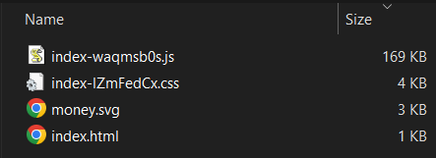
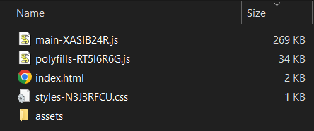
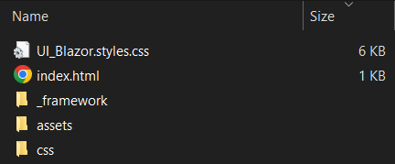
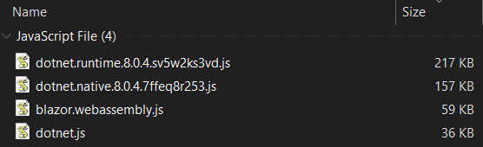
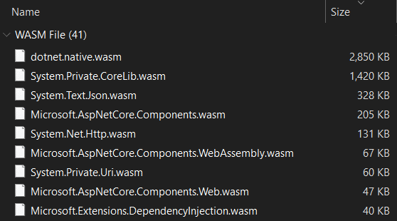
React app bundle
Angular app bundle
Blazor app bundle
Notes:
O’key, we’ve built our application. And what do we have now?
Here you can see the results of the build process.
I think the number of files built for Blazor and other frameworks speaks for itself.
So, let’s move to the next slide

Slide 27
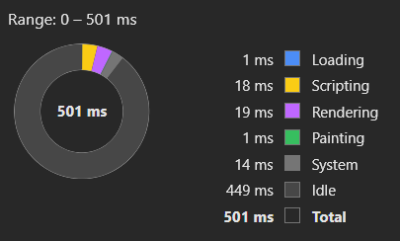
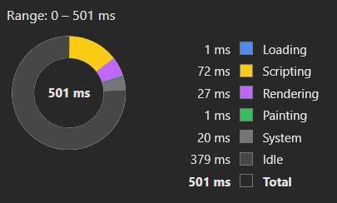
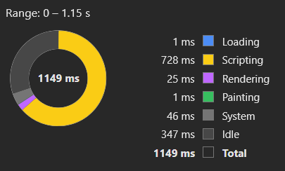
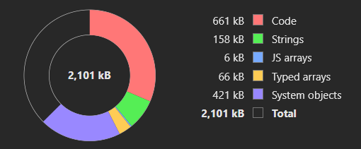
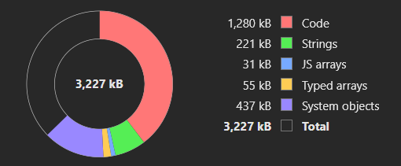
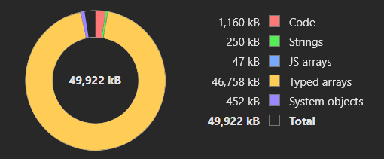
Applications comparison
 | React | Angular | Blazor
Production bundle size (not compressed) | 175 Kb | 321 Kb | 8 Mb
Production bundle size (GZ compressed) | 58 Kb | 92 Kb | 3.1 Mb
Paint time (FP, FCP, LCP metrics) | ~392 ms | ~478 ms | ~1.10 s
Runtime memory snapshot size | 2.1 Mb | 3.2 Mb | 49.9 Mb
Notes:
Here I’ve gathered some statistics for my different application versions.
As you can see, the Blazor bundle size is really huge compared to React and Angular.
As our application is simple, the various painting metrics show pretty much the same value. The Blazor app is the longest to complete rendering with the majority of time spent on scripting (shortly you will see this in action).
And finally, if we will try to compare memory snapshot sizes, we will also see a huge difference in consumed memory between Blazor and two other frameworks.

Slide 28
It’s demo time!

Slide 29
React insights
Pros:
A lot of examples and documentation on the internet
A lot of libraries for almost any use case
The whole UI can be written using a single language and technology stack
As flexible as you can imagine, access to almost every aspect of configuration
Suitable for applications of any scale
Cons:
Must be used in conjunction with other libraries to build a complex application
You must be familiar with JS
Easy to build in a messy way if you are not experienced

Slide 30
Angular insights
Pros:
Has defined structure and preferred ways of building
Easy to find examples on the internet
Can be enriched with external libraries
You can build complex apps out of the box
Rich configuration options
Cons:
May be too complex for a simple application
You must learn a lot of the framework aspects to build a good app

Slide 31
Blazor insights
Pros:
Intuitive components building if you are familiar with the concept
All basic things can be done purely using C#
Relatively easy to get a working application even if you have never touched Blazor
Cons:
Small amount of ready to use libraries
Hard to implement sophisticated things
Hard to find relevant examples and documentation on the internet
Not everything can be done using C# (JS interoperability concept)
Bigger bundle size and hence slower initialization

Slide 32
Instead of conclusion
All three frameworks are very similar in terms of core principles
Blazor is an interesting technology to consider
My personal choice is still React
Notes:
Blazor probably it’s still not mature enough for big projects

Slide 33
What else you can investigate
Application testing
SCSS adoption
Bundle splitting and lazy loading
Complex state management solutions
Ease of reverse-engineering
Security concerns

Slide 34

Thanks for your attention!
Repository with code and presentation:
https://bit.ly/frmwrks1
Contact point:
Artsem Kanapliou (a.kanapliou@godeltech.com)

Slide 35
Any questions?

